Slide 1
Software Quality Assurance and Testing
Lecture -14
Harish Aggarwal

Slide 2
Re-Cap
Lecture - 01
Definitions – S/W Quality, S/W Quality Assurance
Importance of QA
Causes of Defects
Business Models in S/W
S/W Cost, Quality Cost
Quality culture
Lecture - 02
Software Quality Models
McCall, IEEE 1061, ISO 25000 Series
Quality Requirements
Quality of Requirements
Frameworks
ISO/IEC/IEEE 12207 - Software Life Cycle Processes
Lecture - 03
Frameworks
CMMI-Development
ITIL Framework
Other Frameworks
Lecture - 04
ISO 25010 – Quality Attributes
Functional Suitability, Performance Efficiency, Compatibility, Usability, Reliability, Security, Maintainability, Portability
Lecture - 05
Software Testing Fundamentals
Software Verification and Validation
Types of Testing - Black Box, White Box Testing
Test Levels and Types –
Unit, Integration, System Testing
Lecture - 06
Test Design Techniques
Combinatorial Testing
Boundary Value Analysis
Equivalence Class Partitioning
Lecture - 07
Test Methodology –
Decision Table Testing
Test Execution Process
Test Case Design
Automated Testing
Alpha and Beta Site Testing
Regression Testing Strategies
Lecture - 08
Revision

Slide 3
Re-Cap
Lecture - 09
Reviews - Informal Reviews, Formal Reviews
Personal, Peer, Walkthrough, Inspection, Audits
Types of Audits (Internal, Third Party)
Project Assessment and Control Process
Corrective Actions
Lecture - 10
Software configuration Management
Definitions, Benefits
SCM - IEEE 828, ISO 12207, CMMi-Dev
Baseline
Branching
Change Control
Lecture - 11
Introduction to Test Process Improvement
Quality/Test Metrics
Lecture - 12
Test Organization
Roles in Test
Lecture - 13
Agile Test Planning and Execution
Six Sigma in S/W Testing
Continuous Testing in DevOps

Slide 4
Agenda
Measurements
As per ISO 12207
As per PSM
As per ISO/IEC/IEEE 15939
As per CMMI Dev
As per IEEE 730
Reliability Analysis

Slide 5
Measurement
What is not measured, cannot be improved
Key Roles related to Software Measurement
Understand and characterize:
Measures allow us to learn about software processes, products, and services.
Establish baselines, standards, and business and technical objectives
Document the software process models used
Set improvement objectives for software processes, products, and services
Better estimate effort and schedule costs for a specific project

Slide 6
Measurement
Evaluate: Conduct cost/benefit analysis and determine if the objectives have been met
Control: Control of resources, processes, products, and services by sounding alarms when control limits are surpassed, performance criteria are not met and standards are not followed
Predict: when software processes are stable and under control, measures can be used to predict budgets, schedules, resources needed, risks, and even quality issues
Improve: measures allow us to identify the root causes of defects and other inefficiencies where improvements can be proposed.

Slide 7
Measurement Process
Measurement process as described in ISO 12207
Practical software and systems measurement (PSM)
Initially developed to guide American Defense software projects
ISO/IEC/IEEE 15939 standard on software measurement
Systems and Software Engineering - Measurement Process.
Measurement as per CMMI point of view.
Measurement as per IEEE 730.

Slide 8
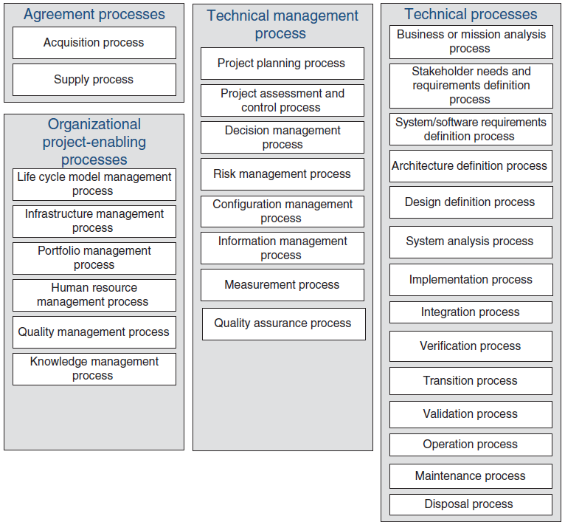
ISO/IEC/IEEE 12207
Software Life Cycle Processes
Establishes a common framework for software life cycle processes.
Each process has –
Title
Purpose
Outcome
Activities
Task

Slide 9
Measurement Process
ISO 12207
Measurement Process
Purpose
The purpose of the Measurement Process is to collect, analyze, and report data relating to the products developed and processes implemented within the organizational unit, to support effective management of the processes, and to objectively demonstrate the quality of the products.
Outcomes
As a result of successful implementation of the Measurement Process:
The information needs of technical and management processes are identified;
An appropriate set of measures, driven by the information needs are identified and/or developed;
Measurement activities are identified and planned;
The required data are collected, stored, analyzed, and the results interpreted;
Information products are used to support decisions and provide an objective basis for communication;
The Measurement Process and measures are evaluated; and
Improvements are communicated to the Measurement Process owner.

Slide 10
Measurement Process
ISO 12207
Activities and tasks
The project shall implement the following activities and tasks in accordance with applicable organization policies and procedures with respect to the Measurement Process.
Measurement planning. This activity consists of the following tasks:
The project shall describe the characteristics of the organization that are relevant to measurement.
The project shall identify and prioritize the information needs.
The project shall select and document measures that satisfy the information needs.
The project shall define data collection, analysis, and reporting procedures.
The project shall define criteria for evaluating the information products and the measurement process.
The project shall review, approve, and provide resources for measurement tasks.
The project shall acquire and deploy supporting technologies.
Measurement performance. This activity consists of the following tasks:
The project shall integrate procedures for data generation, collection, analysis and reporting into the relevant processes.
The project shall collect, store, and verify data.
The project shall analyze data and develop information products.
The project shall document and communicate results to the measurement users.
Measurement evaluation. This activity consists of the following tasks:
The project shall evaluate information products and the measurement process.
The project shall identify and communicate potential improvements.

Slide 11
THE PRACTICAL SOFTWARE AND SYSTEMS
MEASUREMENT METHOD (PSM)
PSM Covers three perspectives
The project manager so as to provide a good understanding of the measures and how to use them to manage their project.
The technical staff that conducts measurement during planning and execution phases; and
The management team so that they can understand the measurement requirements associated with software.

Slide 12
THE PRACTICAL SOFTWARE AND SYSTEMS
MEASUREMENT METHOD (PSM)
PSM – Nine principles
Use issues and objectives to drive the measurement requirements.
Define and collect measures based on the technical and management processes.
Collect and analyze data at a level of detail sufficient to identify and isolate problems.
Implement an independent analysis capability.
Use a systematic analysis process to trace the measures to the decisions.
Interpret the measurement results in the context of other project information.
Integrate measurement into the project management process throughout the life cycle.
Use the measurement process as a basis for objective communications.
Focus initially on project-level analysis.

Slide 13
THE PRACTICAL SOFTWARE AND SYSTEMS
MEASUREMENT METHOD (PSM)
PSM – Ten Parts
Part 1, The Measurement Process
Part 2, Tailor Measures
Part 3, Measurement Selection and Specification Tables
Part 4, Apply Measures
Part 5, Measurement Analysis and Indicator
Part 6, Implement Process
Part 7, Evaluate Measurement
Part 8, Measurement Case Studies
Part 9, Supplemental Information, - glossary, acronyms, etc
Part 10, Department of Defense Implementation Guide

Slide 14
THE PRACTICAL SOFTWARE AND SYSTEMS
MEASUREMENT METHOD (PSM)
PSM – Category of information produced
Schedule
Resources and Costs
Software size and stability
Product Quality
Process Performance
Effectiveness of technology used
User Satisfaction

Slide 15
ISO/IEC/IEEE 15939 STANDARD
Systems and Software Engineering - Measurement Process
ISO 15939 defines a software measurement process that applies to both the systems and software engineering disciplines for software suppliers and acquirers
Outcome of Successful Measurement process –
Information needs are identified
An appropriate set of measures, based on the information needs, is identified or developed
Required data is collected, verified, and stored
The data is analyzed and the results interpreted
Information items provide objective information that supports decisions
Organizational commitment for measurement is sustained
Identified measurement activities are planned
The measurement process and measures are evaluated
Improvements are communicated to the measurement process owner.

Slide 16
ISO/IEC/IEEE 15939 STANDARD
Activity of Measurement process –
Activity 1: Establish and sustain measurement commitment
Accept the requirements for measurement
Assign resources
Activity 2: Prepare for measurement
Define the measurement strategy
Describe the characteristics of the organization that are relevant to measurement.
Identify and prioritize the information needs
Select and specify measures that satisfy the information needs
Define data collection, analysis, access, and reporting procedures
Define criteria for evaluating the information items and the measurement process
Identify and plan for the enabling systems or services to be used
Review, approve, and provide resources for measurement tasks
Acquire and deploy supporting technologies

Slide 17
ISO/IEC/IEEE 15939 STANDARD
Outcome of Successful Measurement process –
Activity 3: Perform measurement
Integrate procedures for data generation, collection, analysis, and reporting into the relevant processes
Collect, store, and verify data
Analyze data and develop information items
Record results and inform the measurement users
Activity 4: Evaluate measurement
Evaluate information products and the measurement process
Identify potential improvements.

Slide 18
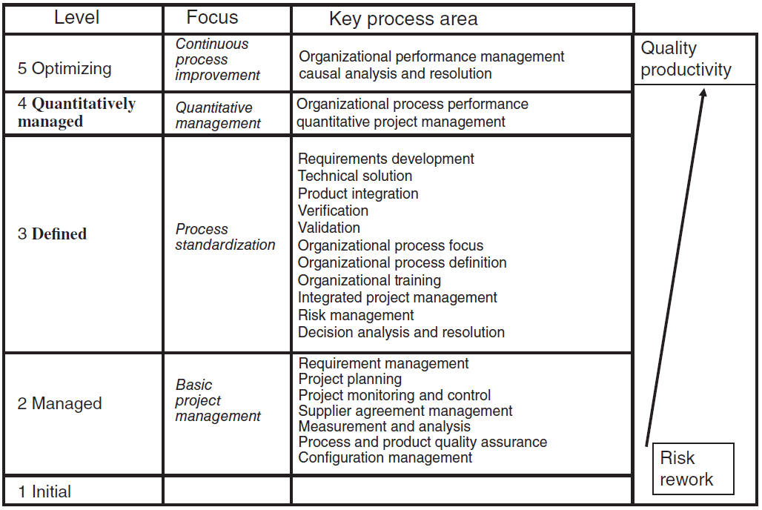
CMMI for Development

Slide 19
Measurement
CMMI - Dev
Measurement and Analysis - The purpose of measurement and analysis (MA) is to develop and sustain a measurement capability used to support management information needs.
SG 1 Align Measurement and Analysis Activities - Measurement objectives and activities are aligned with the identified information needs and objectives.
SP 1.1 Establish measurement objectives
SP 1.2 Specify measures
SP 1.3 Specify data collection and storage procedures
SP 1.4 Specify analysis procedures
SG 2 Provide Measurement Results - Measurement results, which address identified information needs and objectives, are provided.
SP 2.1 Obtain measurement data
SP 2.2 Analyze measurement data
SP 2.3 Store data and results
SP 2.4 Communicate results

Slide 20
Measurement
As per IEEE 730 SQAP
5.4.6 Measure products
5.4.6.1 Purpose
Determine whether product measurements demonstrate the quality of the products and conform to standards and procedures established by the project.
5.4.6.2 Outcomes
This activity shall produce the following outcomes:
Software product measurements conform to project’s processes and plans, and conform to standards and procedures established by the project or organization.
Software product measurements accurately represent software product quality.
Software product measurements are shared with project stakeholders.
Software product measurements are performed on software products developed by the supplier as well as all of the supplier’s subcontractors.
Software product measurements are presented to management for review and potential corrective and preventive action.
Non-conformances are raised when required measurement activities are not performed as defined in project plans.
5.4.6.3 Tasks
To accomplish this activity, the SQA function shall perform the following tasks:
Identify the standards and procedures established by the project or organization.
Determine whether proposed product measurements are consistent with standards and procedures established by the project.
Determine whether the proposed product measurements are representative of product quality attributes.
Analyze product measurement results to identify gaps and recommend improvements to close gaps between measurements and expectations.
Evaluate product measurement results to determine whether improvements implemented as a result of product quality measurements are effective.
Analyze product measurement procedures to confirm they are sufficient to satisfy the measurement requirements defined in project’s processes and plans.
Perform Task 1 through Task 6, above, for software products developed by all subcontractors.

Slide 21
Measurement
As per IEEE 730 SQAP
5.5.5 Measure processes
5.5.5.1 Purpose
Determine whether the process measurements support effective process management and conform to the project’s processes and plans and conform to established standards and procedures.
5.5.5.2 Outcomes
This activity shall produce the following outcomes:
Software process measurement activities conform to project’s processes and plans.
Software process measurement activities conform to standards and procedures established for the project or organization.
Reports documenting software measurement results are prepared and reviewed with project stakeholders and management.
Non-conformances are raised when software measurement activities do not conform to project’s processes and plans.
Software process measurements accurately represent software process quality.
Software process measurements are shared with project stakeholders.
Software process measurements are performed on all of the project’s and subcontractors’ processes.
5.5.5.3 Tasks
To accomplish this activity, the SQA function shall perform the following tasks:
Identify the standards and procedures established for the project or organization.
Evaluate whether the process measurement activities are being executed in conformance to the project’s processes and plans.
Evaluate whether the process measurement activities conform to standards and procedures established by the project and the organization.
Analyze process measurement procedures to confirm they are sufficient to satisfy the measurement requirements defined in project’s processes and plans.
Review the process measurement plan to determine whether the SQA function’s measurement needs are addressed.
Analyze process measurement procedures to confirm they are sufficient to satisfy the measurement requirements defined in project plans and the contract.
For each subcontractor, perform Task 1 through Task 6, above, for each of their software processes.

Slide 22
Reliability Analysis
Reliability theory is concerned with determining the probability, that a system, possibly consisting of many components will function.
Overall, System components can be treated in configurations
Series System: System will function if all components are functioning
Parallel System: System will function if one of the component is functioning. (Provided the ultimate aim is to have the same component working).
Composite System: (Series + Parallel) in varying configurations

Slide 23
Reliability Analysis
Each component will function with some known probability (independent of each other)
Upper and lower bounds of probability
A component may show a dynamic behavior over time i.e. it functions for a random length of time and after which it fails
Amount of time a system functions is related to the distribution of a component lifetimes
In particular, it turns out that if the amount of time that a component functions has an increasing failure rate on average distribution, then so does the distribution of system lifetimes

Slide 24
Reliability Analysis
This study gives us the mean life time of a system
Analysis requires us to look at the system when failed components are subjected to repair
# of defects
Test Cycles

Slide 25
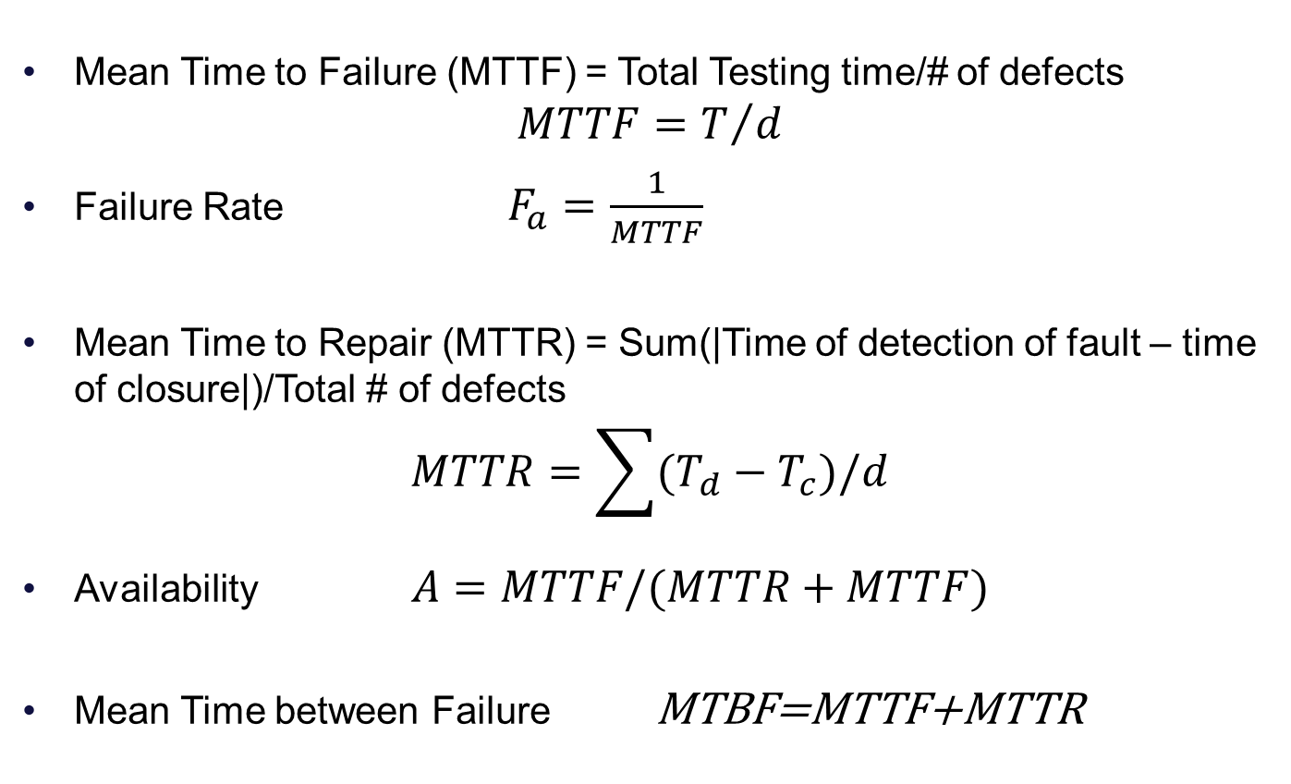
Reliability Analysis
Mean Time to Failure (MTTF) = Total Testing time/# of defects
$$MTTF=T/d$$
Failure Rate$F_{a}=\frac{1}{MTTF}$
Mean Time to Repair (MTTR) = Sum(|Time of detection of fault – time of closure|)/Total # of defects
$$MTTR=\sum{(T_{d}−T_{c})/d}$$
Availability$A=MTTF/(MTTR+MTTF)$
Mean Time between Failure MTBF=MTTF+MTTR

Slide 26
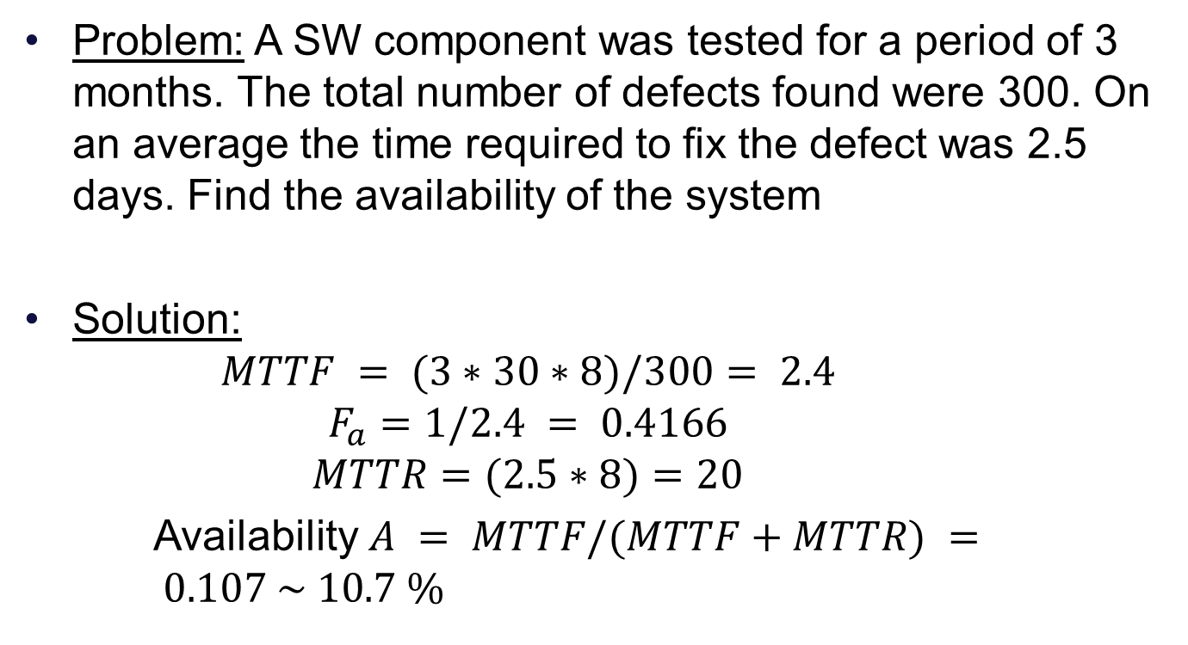
Reliability Analysis
Problem: A SW component was tested for a period of 3 months. The total number of defects found were 300. On an average the time required to fix the defect was 2.5 days. Find the availability of the system
Solution:
$$MTTF = (3∗30∗8)/300= 2.4$$
$$F_{a}=1/2.4 = 0.4166$$
$$MTTR=(2.5∗8)=20$$
Availability $A = MTTF/(MTTF+MTTR) = 0.107 \sim 10.7 \%$

